Slide 1
Genetic Distance
Dr Rachel Cavill

Slide 2
The genetic distance problem
Given a pair of aligned sequences, how do we estimate how many generations have passed between these two individuals having a common ancestor?
This is called the genetic distance

Slide 3
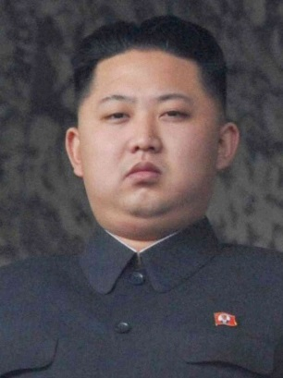

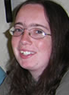
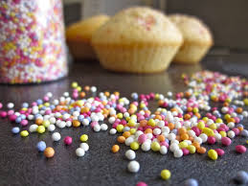
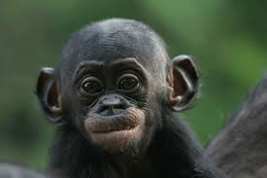

Which representative of the species?
Which human?
Answer one:
Answer two: it doesn’t matter
We are all far more similar to each other than we are to even our closest relatives
These sprinkles may vary in size,
But compared to a beach ball they’re all the same.

Slide 4
How different are we?
If you took two random humans, how many base pairs would you have to look at (on average) before you found one which was different?

Slide 5
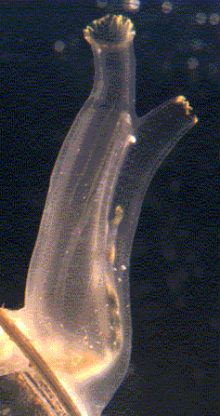
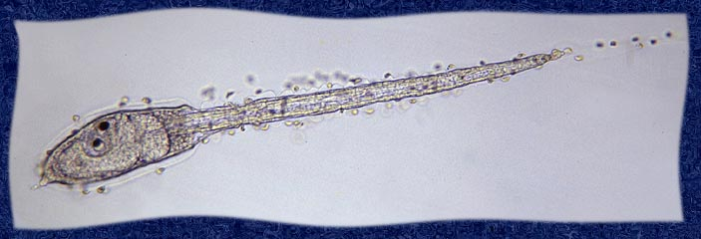
How different are we?
If you took two random humans, how many base pairs would you have to look at (on average) before you found one which was different?
Answer: 1500 (0.067%)
Other organisms have much higher rates
Ciona have levels of genetic variation between 1 and 5%

Slide 6
Single Nucleotide Polymorphisms (SNPs)
When a point mutation occurs (due to a copying error), this is called a SNP
Eg
AAATAAAA
AAACAAAA
The different possibilities in a single position are called alleles.

Slide 7
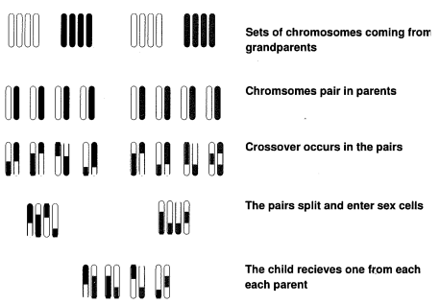
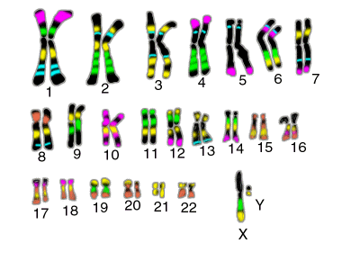
How does variation occur?
Even closely related individuals differ in their genetic sequences. This is due to;
Point mutations – copying errors
Sexual reproduction – our diploid genome

Slide 8
Two types of DNA in our cells
Nuclear DNA
Mitochondrial DNA
Found in our chromosomes in the nucleus of our cells
Obtained equally from both parents
Found in the mitochondria – an organelle in the cytoplasm of our cells
Obtained from our mothers.
The existance of mitochondrial DNA allows us to track the maternal line. For instance, we can estimate when humans left Africa for Europe, by calculating the genetic distance in the mitochrondrial DNA between European individuals.

Slide 9
Mutations becoming the norm
A mutation originates in one individual.
After many generations it could become the ‘norm’ if it is now in all individuals in the population
This is called becoming fixed
The mutation rate is the rate at which new mutations occur
The substitution rate is the rate at which new mutations become fixed in the population

Slide 10
Evolution
Evolution is driven by mutations
Some mutations are beneficial, these have a higher probability of becoming fixed
Some mutations are neutral
Some are deletrious, these have a lower probability of becoming fixed.
Note Anything is possible – good mutations may become lost through chance and even harmful mutations may become fixed.

Slide 11
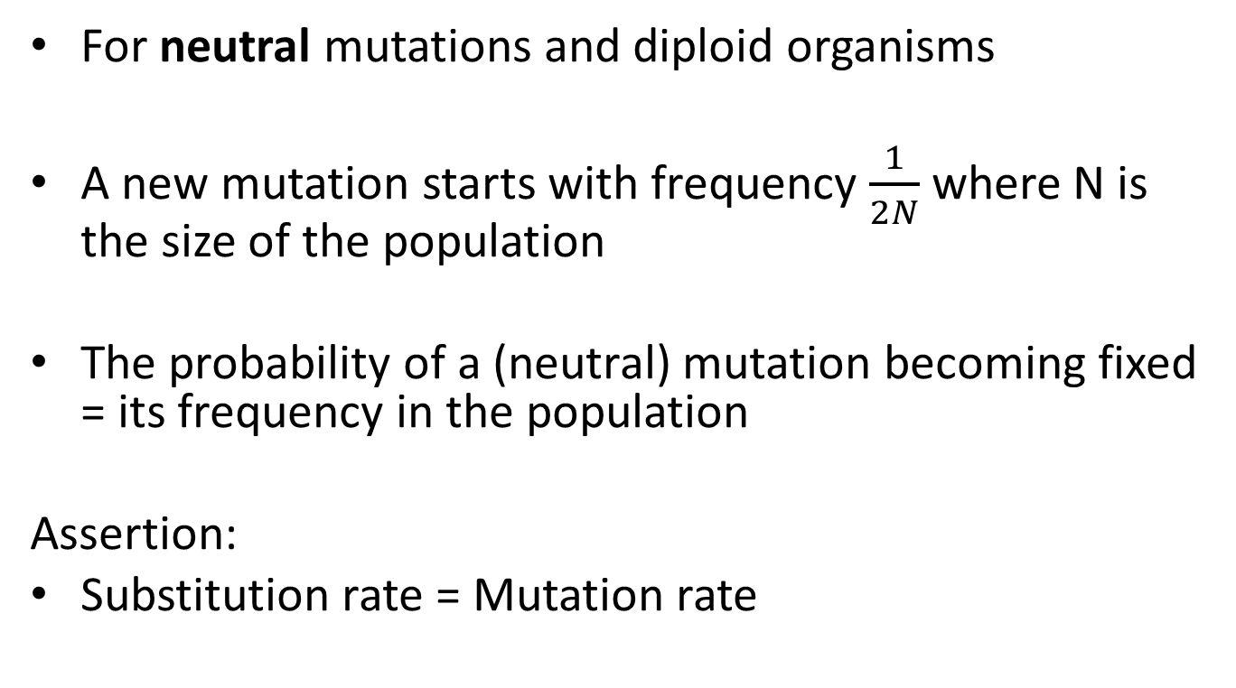
Substitutions and mutations
For neutral mutations and diploid organisms
A new mutation starts with frequency $\frac{1}{2N}$ where N is the size of the population
The probability of a (neutral) mutation becoming fixed = its frequency in the population
Assertion:
Substitution rate = Mutation rate

Slide 12

Proof: substitution=mutation
If $ρ$ is the substitution rate and μ the mutation rate
$$ρ=2N μ \left(\frac{1}{2N}\right)= μ$$
So the substitution rate is independent of the population size.
Number of copies of each gene in the population (diploid population, so each individual has 2 copies of each gene)
Rate at which each gene is mutated
Frequency of a new mutation in the population

Slide 13
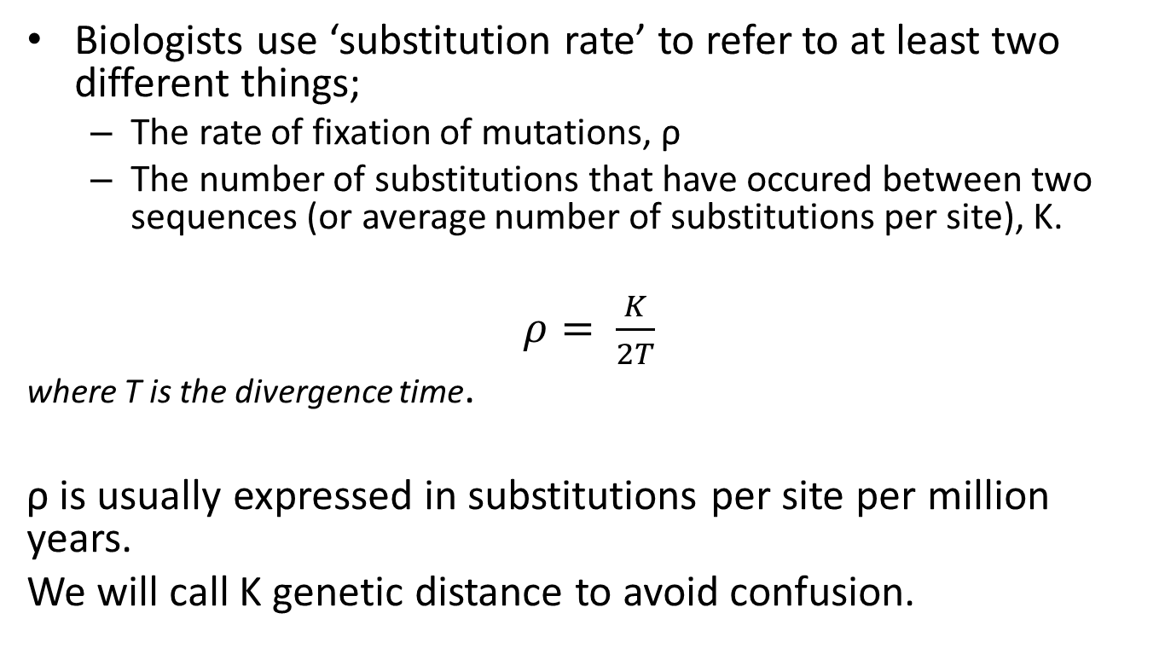
Two types of substitution rate…
Biologists use ‘substitution rate’ to refer to at least two different things;
The rate of fixation of mutations, ρ
The number of substitutions that have occured between two sequences (or average number of substitutions per site), K.
$ρ= \frac{K}{2T}$
where T is the divergence time.
ρ is usually expressed in substitutions per site per million years.
We will call K genetic distance to avoid confusion.

Slide 14
Proportional genetic distance
A simple way to estimate genetic distance is to look at the proportion of bases in the sequences which are different.
Advantages – simple
Disadvantages – becomes increasingly inaccurate as time passes, saturation

Slide 15
Saturation
* Saturation: is when there is on average one substitution per site
* Two random sequences of equal length will match for approximately ¼ of their sites
* In saturation therefore the proportional genetic distance is ¼

Slide 16
Estimating genetic distance
* True genetic distance (proportion): K
* Observed proportion of differences: d
* Due to back-mutations K ≥ d

Slide 17

Example
How many times have I repainted a cylinder?

Slide 18

Example
1
2
3
4
5

Slide 19
How long ago?
If we have two species with 100/10000 bases different in their sequences
We might know that on average 2 SNPs will newly occur per generation
How many generations have passed since the split?

Slide 20
How long ago?
Naïvely we think that our 2 mutations per generation means that these species split 50 generations ago.
BUT, mutations can be forward and backwards
Or mutations can take place at the same position and hence be hidden

Slide 21
Estimating genetic distance
Multiple substitutions and Back-mutations conceal the real genetic distance
GACTGATCCACCTCTGATCCTTTGGAACTGATCGT
TTCTGATCCACCTCTGATCCTTTGGAACTGATCGT
TTCTGATCCACCTCTGATCCATCGGAACTGATCGT
GTCTGATCCACCTCTGATCCATTGGAACTGATCGT
observed : 2 (= d)
actual : 6 (= K)

Slide 22
Model building cycle
Build model
Test model with real data
Evaluate model fit
Hypothesise why model fails to fit
Plan a more complex model which may fit better
Plan simplest model which may fit data
End
(use model)
good
bad

Slide 23
Simplest model
All substitutions are equally likely
Substitution probability per site per generation is α
Substitution means there are 3 possible replacements
(e.g. C → {A,G,T})
Non-substitution means there is 1 possibility
(e.g. C → C)

Slide 24
Building our model
Therefore, the one-step Markov process has the following transition matrix:
M_{JC} =
A C G T
A 1-α α/3 α/3 α/3
C α/3 1-α α/3 α/3
G α/3 α/3 1-α α/3
T α/3 α/3 α/3 1-α
Substitution probability per site per generation is α

Slide 25
Powers of matrices
To calculate the probability of a substitution being visible (not obscured by back substitutions) after t generations, we need to look at M_{JC}^{t}
If we have eigenvectors and eigenvalues of the matrix, we can get powers easily.

Slide 26
Matrix diagonalization: reminder
When we diagonalise a square matrix we find an invertible matrix P and a diagonal matrix D such that A=PDP⁻¹
P is made up from the eigenvectors of A
D is made by putting the corresponding eigenvalues along the diagonal.

Slide 27
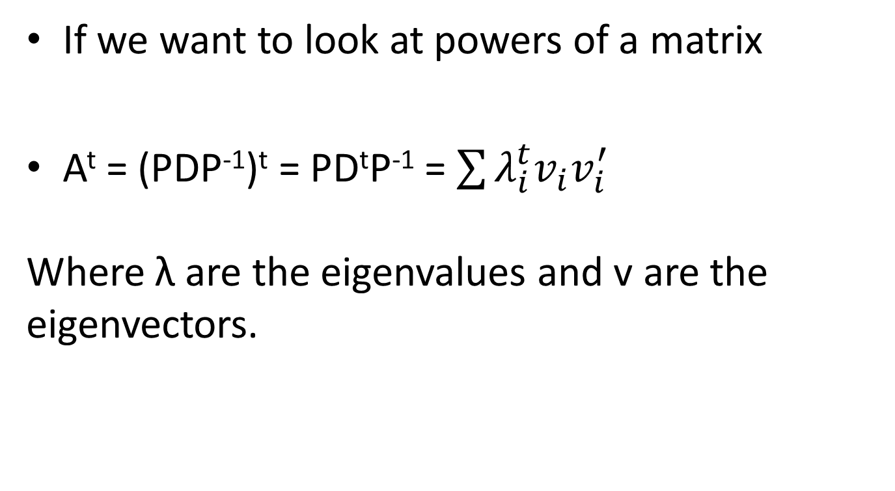
Why diagonalise?
If we want to look at powers of a matrix
A^{t} = (PDP⁻¹)^{t} = PD^{t}P⁻¹ = $\sum{λ_{i}^{t}{v_{i}v}_{i}^{′}}$
Where λ are the eigenvalues and v are the eigenvectors.

Slide 28
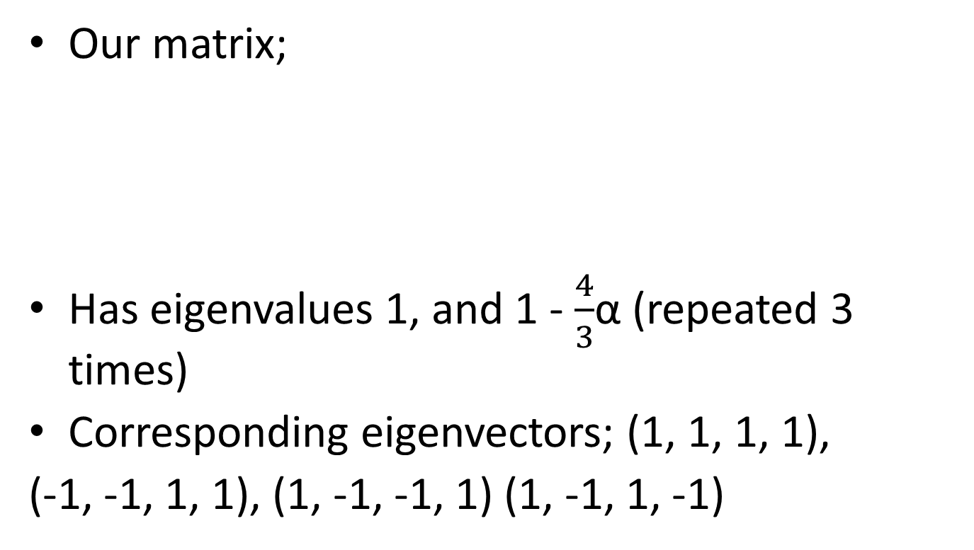
Eigenvectors and eigenvalues of M_{JC}
Our matrix;
Has eigenvalues 1, and 1 - $\frac{4}{3}$α (repeated 3 times)
Corresponding eigenvectors; (1, 1, 1, 1),
(-1, -1, 1, 1), (1, -1, -1, 1) (1, -1, 1, -1)
A C G T
A 1-α α/3 α/3 α/3
C α/3 1-α α/3 α/3
G α/3 α/3 1-α α/3
T α/3 α/3 α/3 1-α

Slide 29
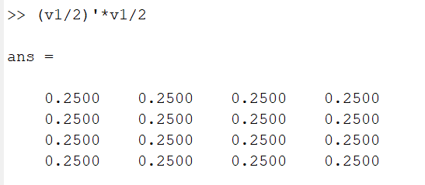
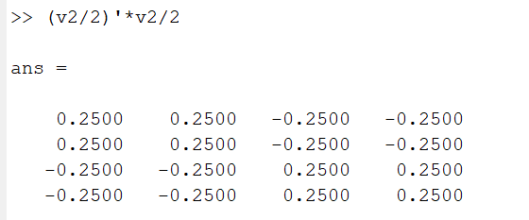
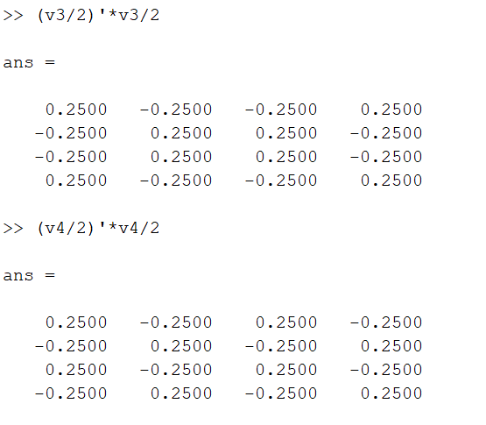
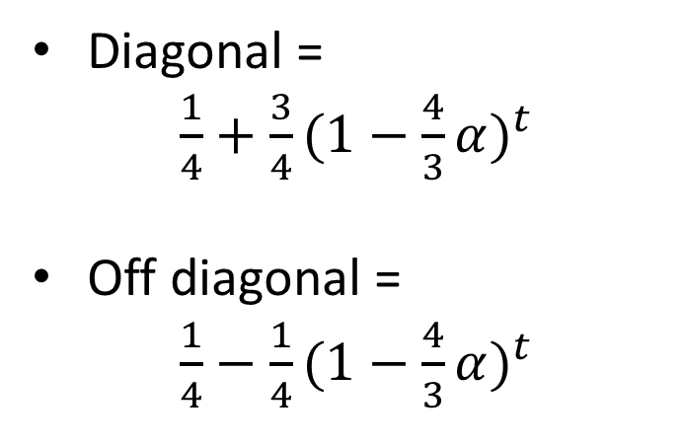
v*v’
The vectors are length 2, so dividing by 2 normalises them and allows us to do symmetric diagonalisation
Diagonal =
$\frac{1}{4}+\frac{3}{4}(1−\frac{4}{3}α)^{t}$
Off diagonal =
$\frac{1}{4}−\frac{1}{4}(1−\frac{4}{3}α)^{t}$

Slide 30
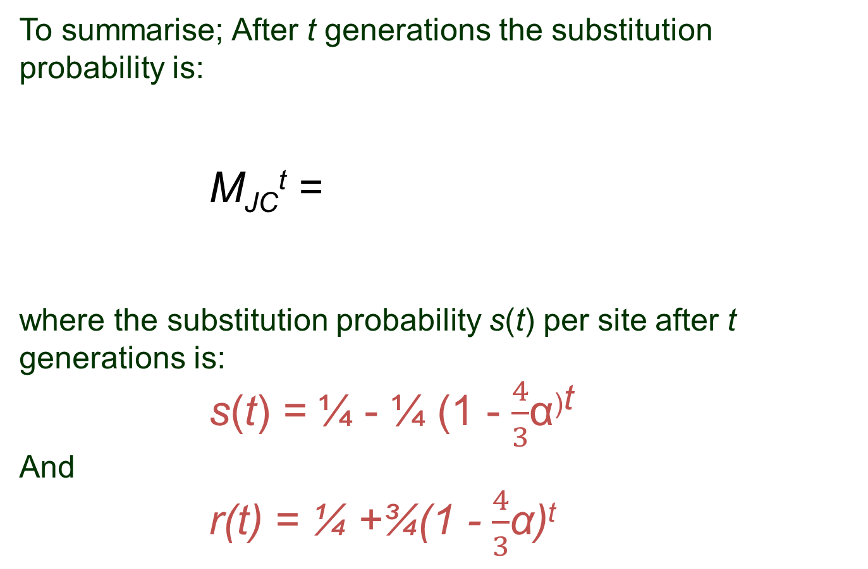
To summarise; After t generations the substitution probability is:
M_{JC}^{t} =
where the substitution probability s(t) per site after t generations is:
s(t) = ¼ - ¼ (1 - $\frac{4}{3}$α^{)t}
And
r(t) = ¼ +¾(1 - $\frac{4}{3}$α)^{t}
r(t) s(t) s(t) s(t)
s(t) r(t) s(t) s(t)
s(t) s(t) r(t) s(t)
s(t) s(t) s(t) r(t)

Slide 31
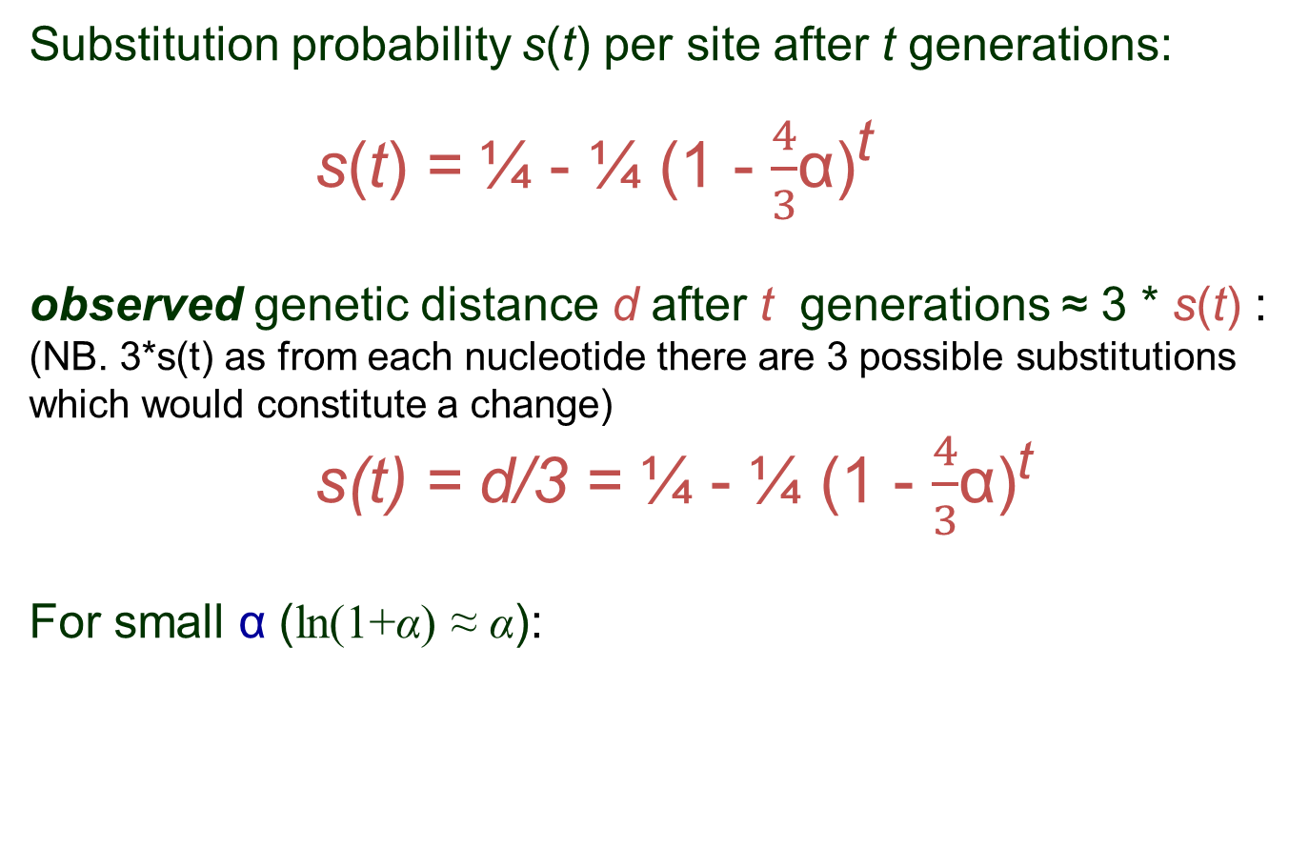
Substitution probability s(t) per site after t generations:
s(t) = ¼ - ¼ (1 - $\frac{4}{3}$α)^{t}
observed genetic distance d after t generations ≈ 3 * s(t) :
(NB. 3*s(t) as from each nucleotide there are 3 possible substitutions which would constitute a change)
s(t) = d/3 = ¼ - ¼ (1 - $\frac{4}{3}$α)^{t}
For small α (ln(1+α) ≈ α):

Slide 32
For small α the time (in generations) can be written as:
The actual genetic distance is:
K = αt
So:
This is the Jukes-Cantor formula : independent of α and t.

Slide 33
The Jukes-Cantor formula :
For small d using ln(1+x) ≈ x : K ≈ -¾ * -4/3d = d
So: actual distance ≈ observed distance
For saturation: d ↑ ¾ : K →∞
So: if observed distance corresponds to random sequence-distance then the actual distance becomes indeterminate

Slide 34
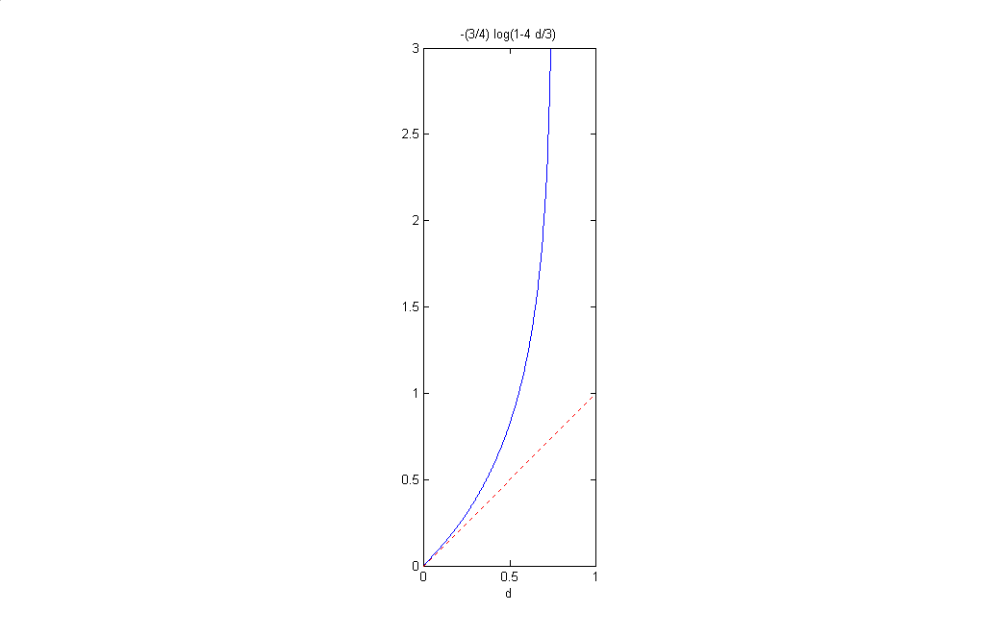
Jukes-Cantor

Slide 35
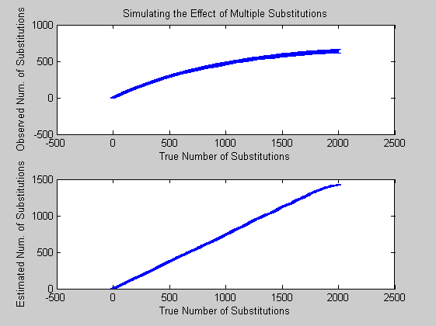

Slide 36
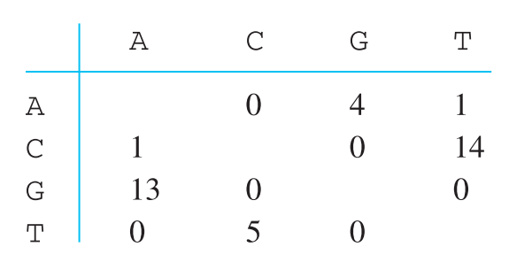
Test the model with real data
Substitutions in mitochondrial DNA for two humans
Does this fit our model assumptions?

Slide 37
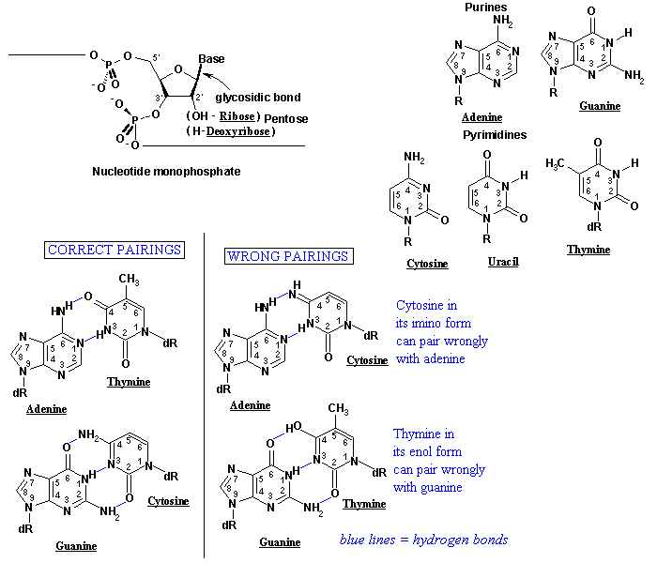
Hypothesise why the model fails

Slide 38
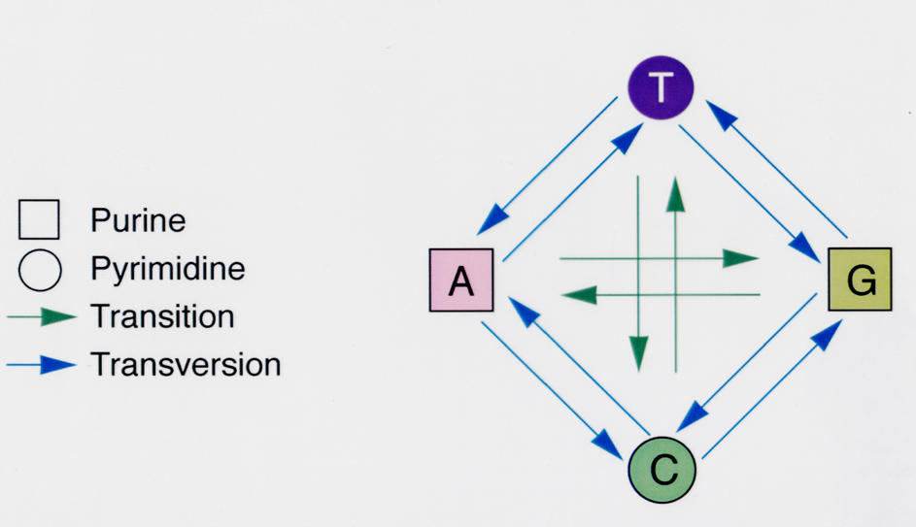
Transitions – Transversions
Transitions more likely than transversions
Transitions less harmful (more to be likely same Amino Acid)

Slide 39
Plan a more complex model
Include substitution bias in correction factor
Transition probability (G↔A and T↔C) per site per second is α
Transversion probability (G↔T, G↔C, A↔T, and A↔C) per site per second is β

Slide 40
Build model (round 2)
The one-step Markov process substitution matrix
now becomes:
M_{K2P} =
A C G T
A 1-α-2β β α β
C β 1-α-2β β α
G α β 1-α-2β β
T β α β 1-α-2β

Slide 41
Kimura model
Determine fraction of transitions per site after t generations : P(t)
Determine fraction of transversions per site after t generations : Q(t)
Genetic distance: K ≈ - ½ ln(1-2P-Q) – ¼ ln(1 – 2Q)
Fraction of substitutions d = P + Q → Jukes-Cantor

Slide 42
For the exam…
You will get the Jukes-Cantor and Kimura equations in the appendices.
You should be able to use these equations to calculate genetic distance from data or calculate observed distance from real genetic distance.
You should understand why these corrections are necessary and the difference between the two corrections.

